Slide 1
Why Cash Flow is Essential
SBDC expertise and resources available for your business

Slide 2
61%
82%
of small businesses regularly struggle with cash flow
of business failures are due to poor cash flow management skills / poor understanding of cash flow
1
Cash flow matters in every business
2
69%
43%
of small business owners have been kept up at night by concerns about cash flow
of small business owners have been at risk of not paying employees by payday
1
1
1 – Wakefield Research survey – Jan 2019
2 – Preferred CFO Study – March 2017
Copyright Finagraph – All Rights Reserved

Slide 3
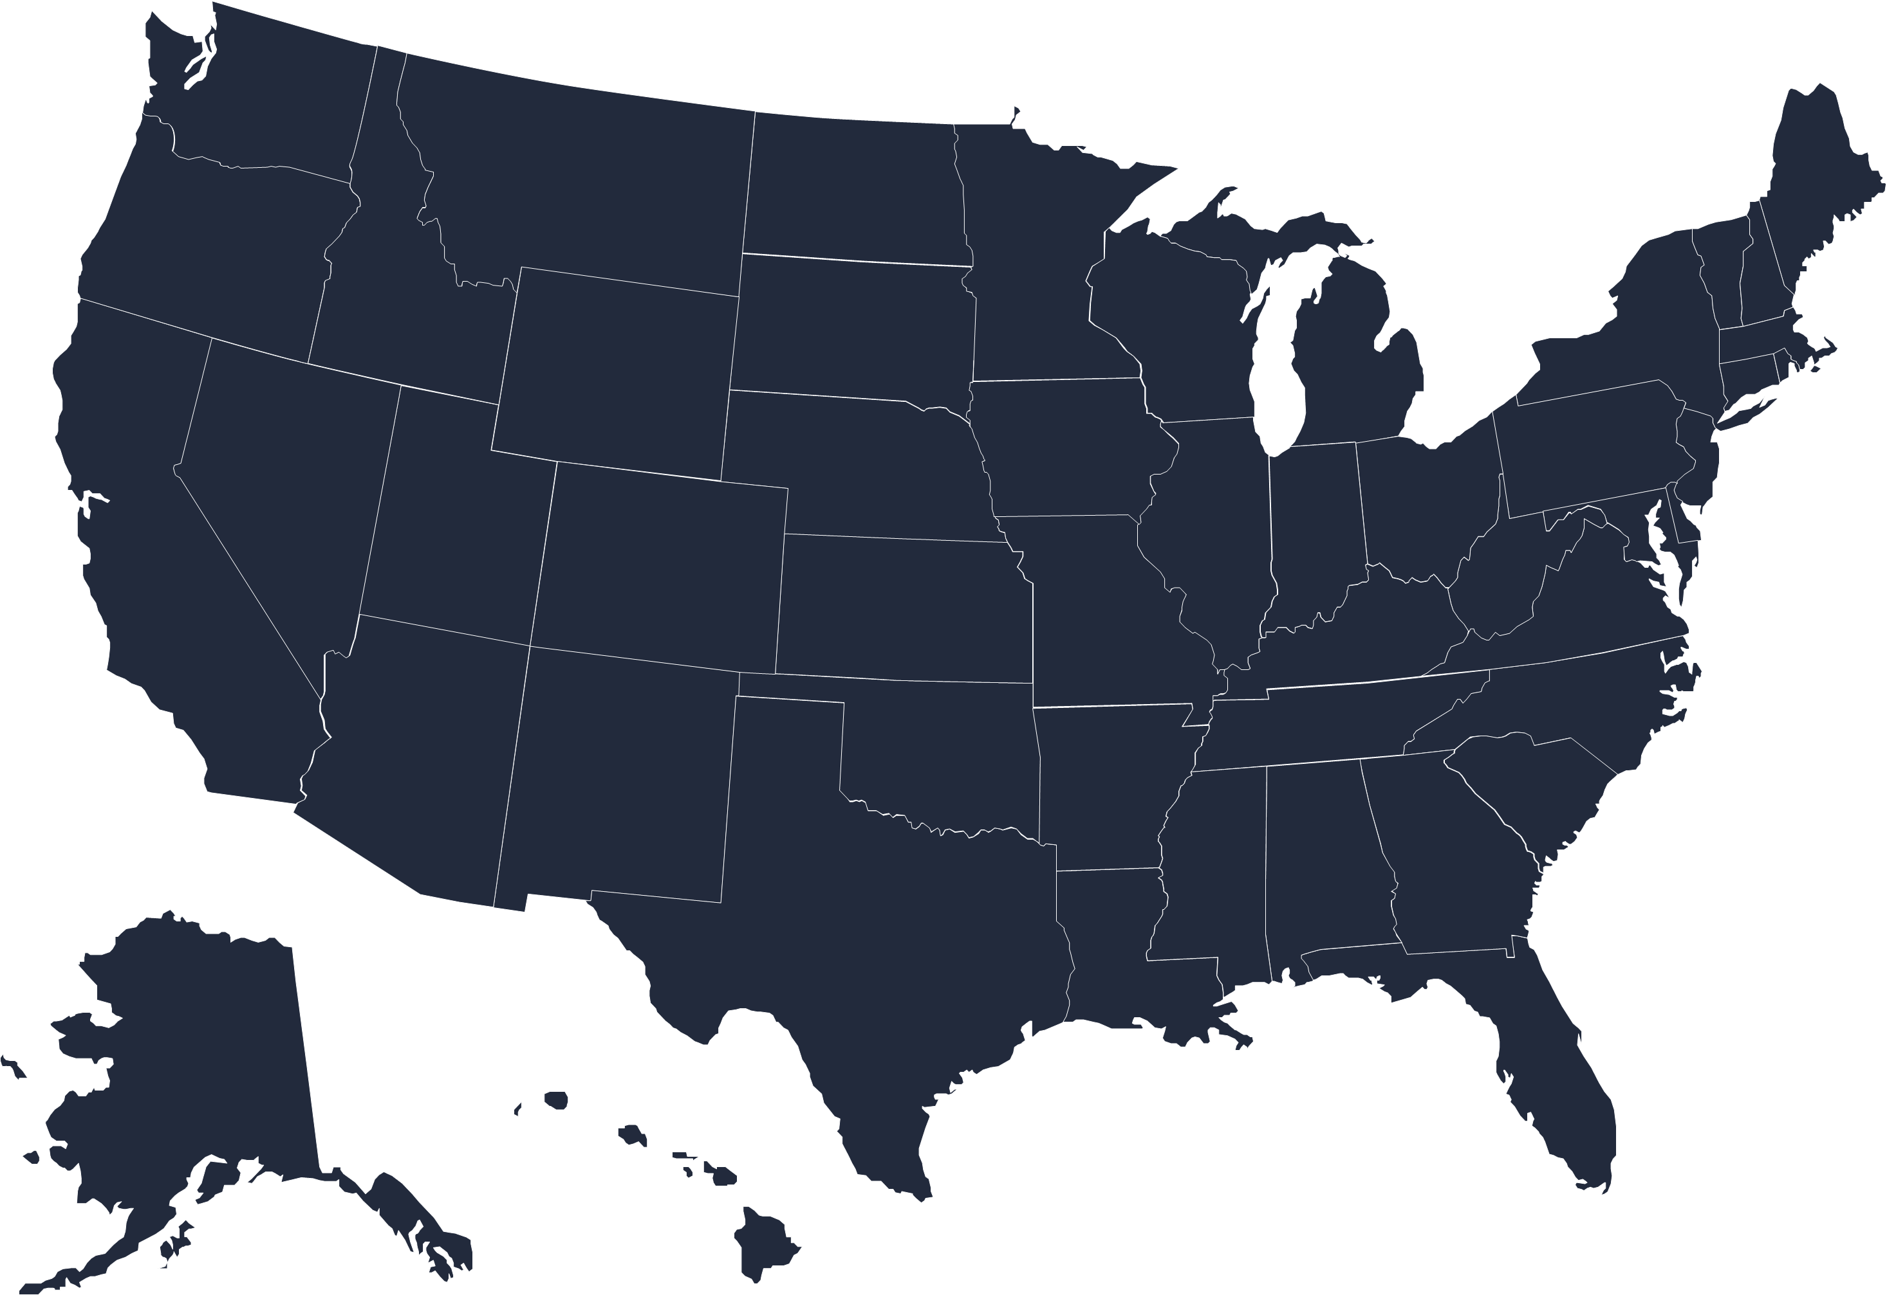
In just the last 3 months:
200
K
110
100
125
145
155
170
190
10
50
1
Small Business Across the US
businesses failed
2
28M
10%
82%
15%
20%
25%
40%
50%
60%
70%
80%
of the failed businesses had a cash flow problem
3
small businesses
in the US
1
10%
35%
12%
14%
15%
17%
20%
24%
27%
31%
thought they were making money
2
~70k businesses failed while they thought they were making money…
1 - Small Biz in the US – May 2017 (https://townsquared.com/ts/resources/small-business-united-states-numbers/)
2 – 2018 Small Business Profiles (www.sba.gov/sites/default/files/advocacy/2018-Small-Business-Profiles-US.pdf)
3 - Preferred CFO study – March 2018 (www.preferredcfo.com/cash-flow-reason-small-businesses-fail)

Slide 4
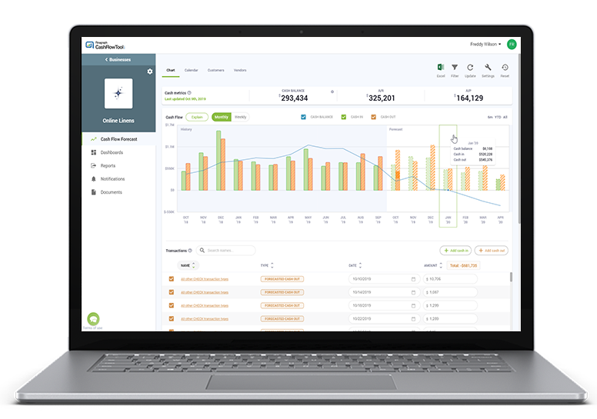
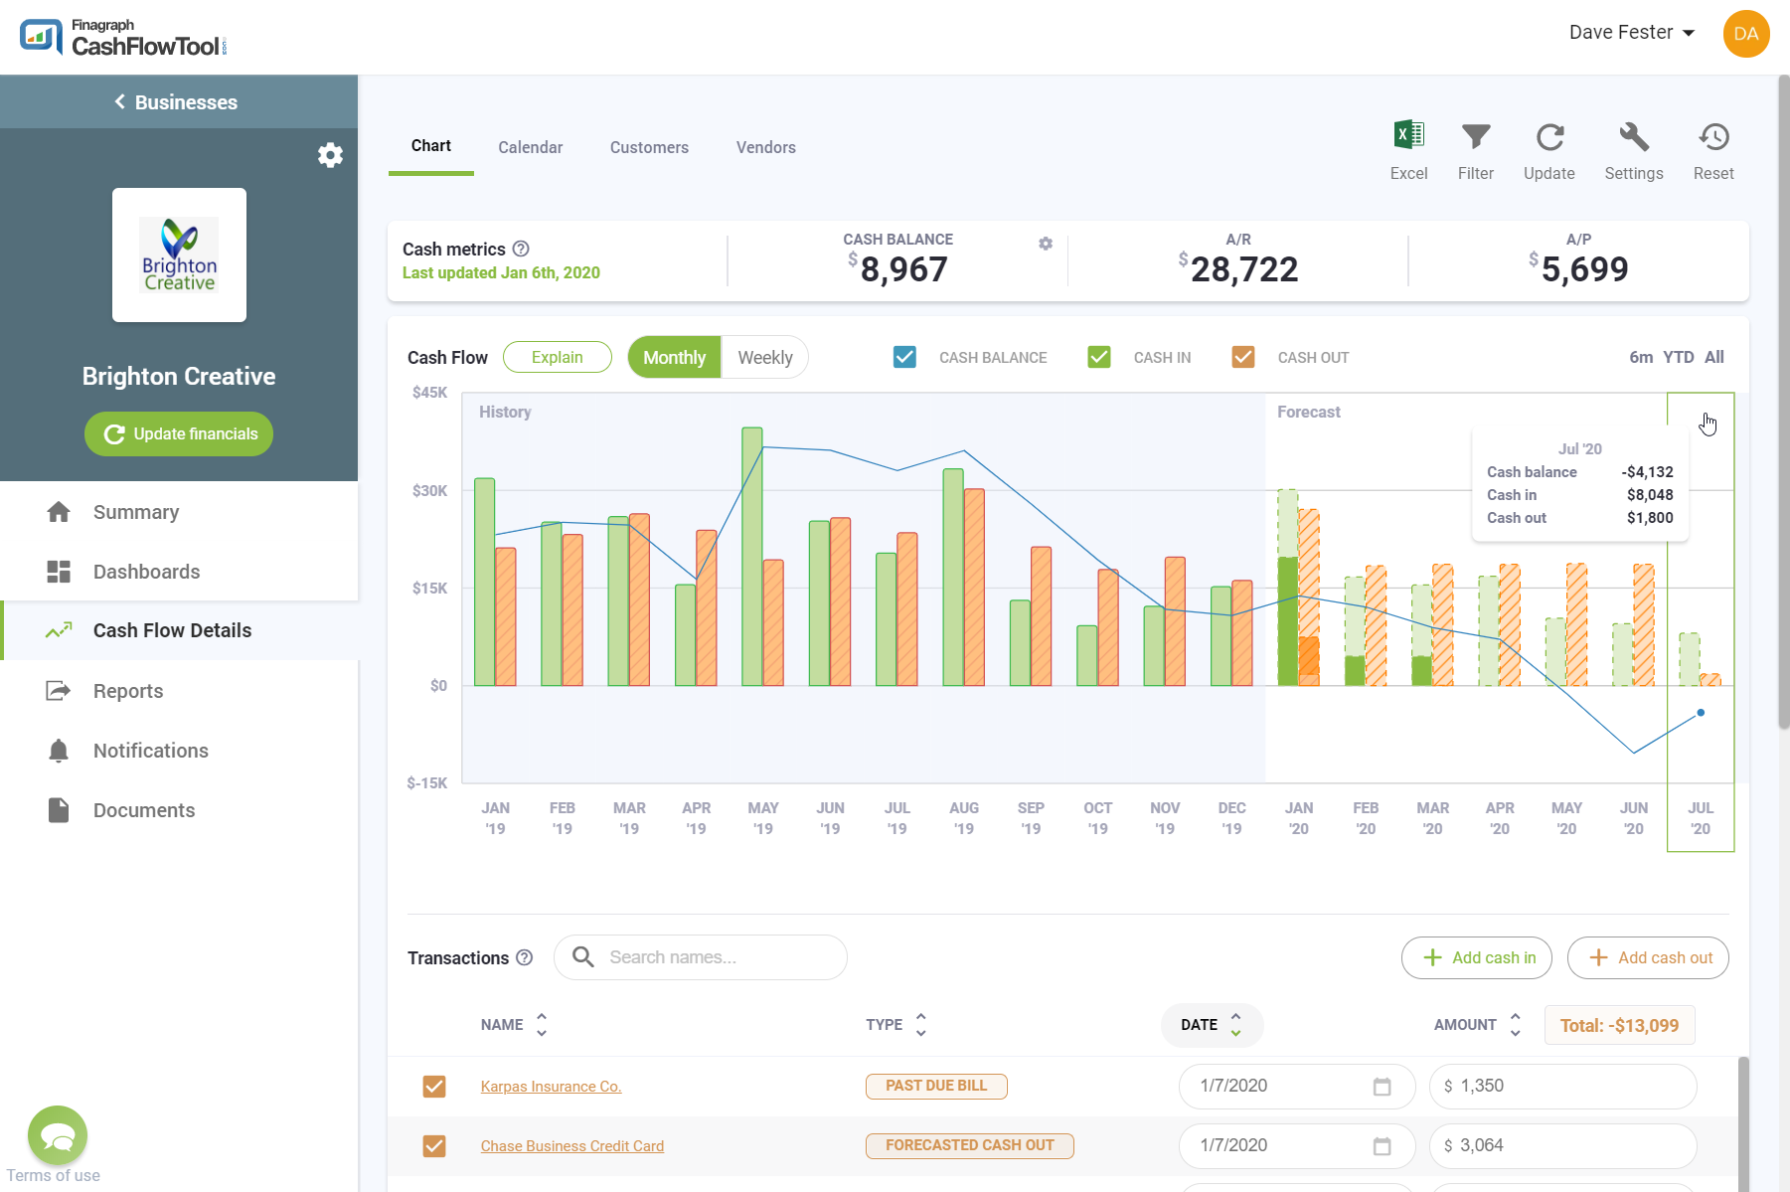
Free Cash Flow Resources Available to your Business
Thanks to an initiative from Moody’s “Pathway to Prosperity”, Finagraph has made these available to you for free
1
Business Cash Flow Essentials Training
2
50% discount on CashFlowTool
3
CashFlowTool Training
This course is designed to educate and equip you with critical and essential cash flow concepts that every business needs to maximize their cash flow and profits in a simple, yet powerful way
The 50% discount enables your business to immediately see your current and future cash flow. It’s the #1 rated cash flow app on the QuickBooks Marketplace
Learn how to make the most of CashFlowTool for your business. You will learn how to setup CashFlowTool, how predictions work, how to do scenario planning and much more.
4
SBDC Advisors are Cash Flow Experts
We are ready to help your business with cash flow advice and recommendations. We can collaborate on a regular basis to help your business either survive a cash flow crisis or thrive even more.

Slide 5
Take the Business Cash Flow Essentials course
This course is designed to educate and equip you with critical and essential cash flow concepts that every business needs to maximize their cash flow and profits in a simple, yet powerful way.
1
6 interactive lessons – 2 hr 30 min
Learn cash flow essentials & immediately apply concepts in CashFlowTool
Exclusive resources
Downloadable materials to follow along during each lesson
Lessons Topics
The Importance Of Cash Flow In Business
The Speed of Cash
Ratios & Financial Analysis (Part A)
Ratios & Financial Analysis (Part B)
Silent Killers of Cash Flow
Forecasting
cashflowtool.com/sbdc/bcfe-course

Slide 6
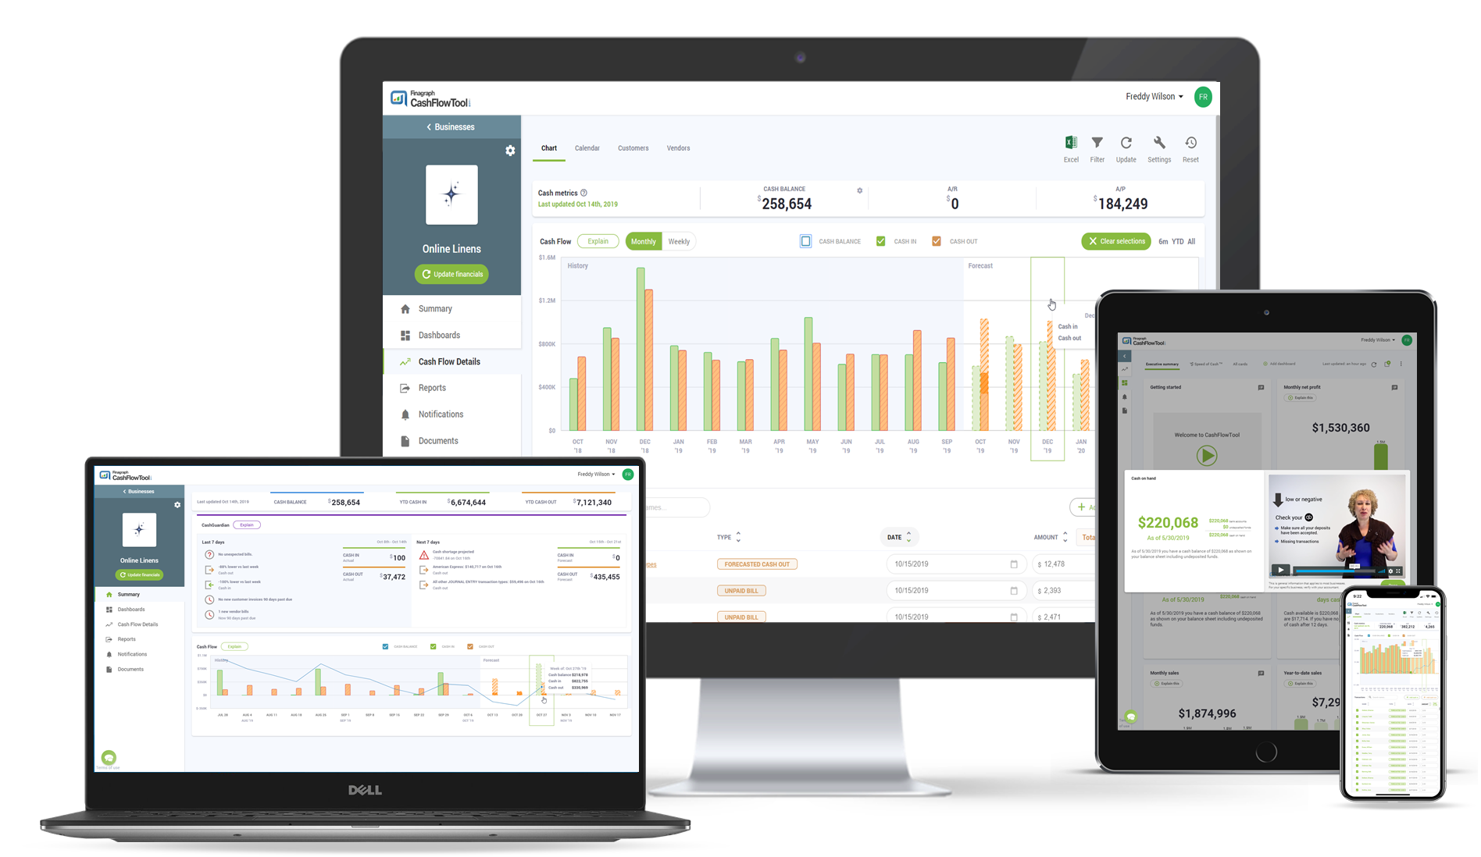
50% off a subscription to CashFlowTool Pro
As an SBDC client, you get 50% off CashFlowTool Pro
2
https://www.cashflowtool.com/sbdc/clients#get-it-now

Slide 7
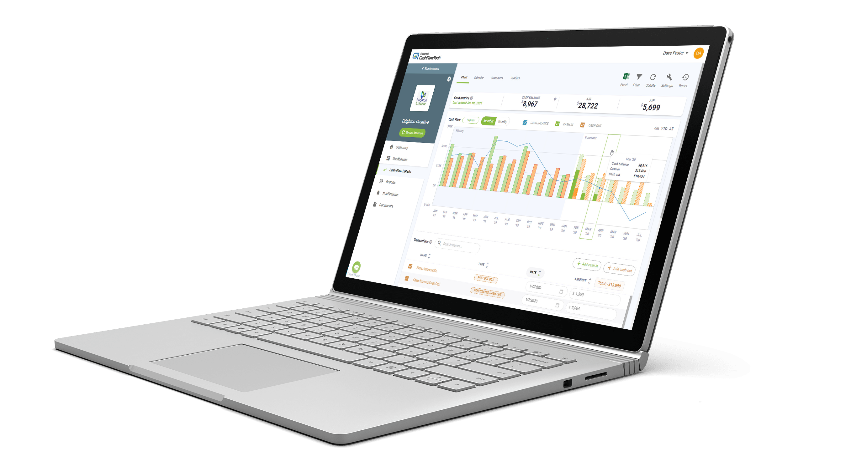
AI-powered cash flow monitoring and forecasting
Powerful forecasts in seconds
Flexible reporting + visualizations
Critical insights into customer and vendor details
Easy collaboration between SMBs and their advisors
Industry leading Partner Program with training + support for advisors

Slide 8
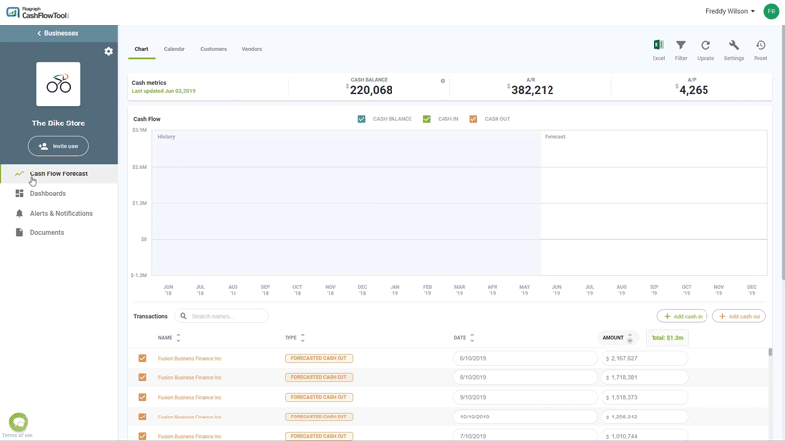
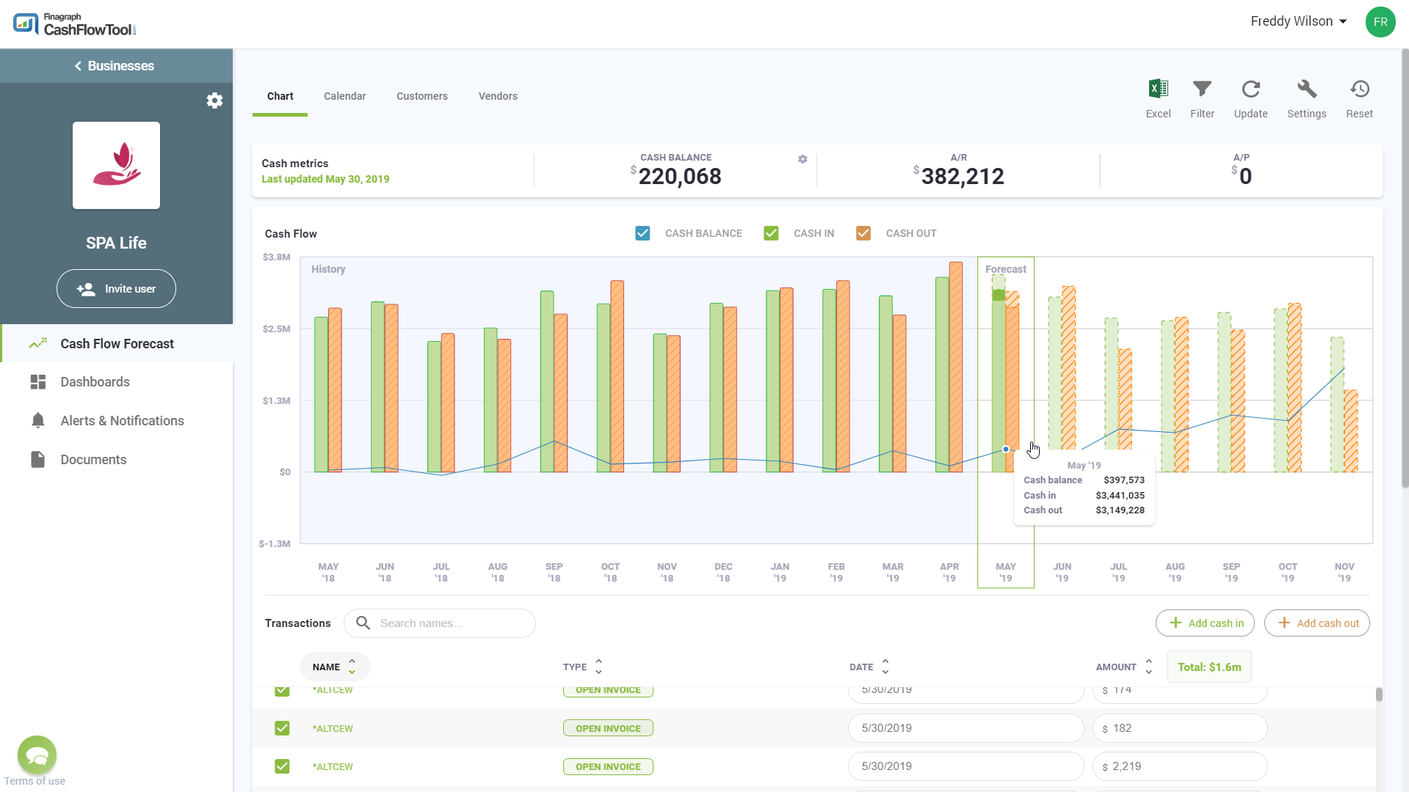
Demo

Slide 9
Get Certified as a Cash Flow Pro
This is a premium certification course where you can learn everything you need to master CashFlowTool
3
9 interactive lessons – 2 hr 35 min
Lessons Topics
Understand the reasons that cash flow is essential
Learn all aspects of CashFlowTool including forecasting, dashboard KPIs, what-ifs, collaboration and more
Learn how CashFlowTool works in a variety different businesses
Learn the best ways to roll it out and begin cash flow advising
Pass the test and become an official CashFlowTool Certified Pro
cashflowtool.com/sbdc/cft-certification

Slide 10
We are here to help you with Cash Flow!
We are experts in cash flow management & forecasting
4
Jumpstart your business with cash flow expertise
We can evaluate how your business is doing with CashFlowTool
We can offer recommendations & advice
We can collaborate on a regular basis

Slide 11
Questions?

Slide 12
Master your cash flow today
cashflowtool.com/sbdc/clients

